Slide 1
Web Client and UDP Socket CS F303
Dr. Pranav M. Pawar

Slide 2
Problem Statement
Develop a UDP server using java and verify using the UDP client

Slide 3
Socket Programming with UDP
UDP
Connectionless and unreliable service.
There isn’t an initial handshaking phase.
Doesn’t have a pipe.
transmitted data may be received out of order, or lost
Socket Programming with UDP
No need for a welcoming socket.
No streams are attached to the sockets.
the sending hosts creates “packets” by attaching the IP destination address and port number to each batch of bytes.
The receiving process must unravel to received packet to obtain the packet’s information bytes.

Slide 4
Example: Java client (UDP)
Client
process
Input: receives packet (UDP received “byte stream”)
Output: sends packet (UDP sent “byte stream”)
client UDP socket

Slide 5
Client/server socket interaction: UDP
Server (running on hostid)
Client
create socket,
port=x, for
incoming request:
create socket,
clientSocket =
DatagramSocket()
serverSocket =
DatagramSocket()
Create, address (hostid, port=x,
send datagram request
using clientSocket
read request from
serverSocket
write reply to
serverSocket
specifying client
host address,
port umber
read reply from
clientSocket
close
clientSocket

Slide 6
JAVA UDP Sockets
In Package java.net
java.net.DatagramSocket
A socket for sending and receiving datagram packets.
Constructor and Methods
DatagramSocket(int port): Constructs a datagram socket and binds it to the specified port on the local host machine.
void receive( DatagramPacket p)
void send( DatagramPacket p)
void close()

Slide 7
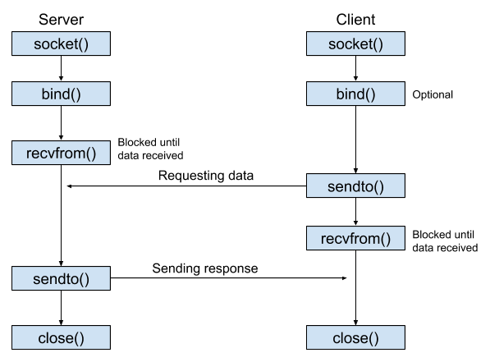
UDP Socket Programming
Working of UDP Socket

Slide 8
UDP Socket in Java Example
UDP Server
UDP Client

Slide 9
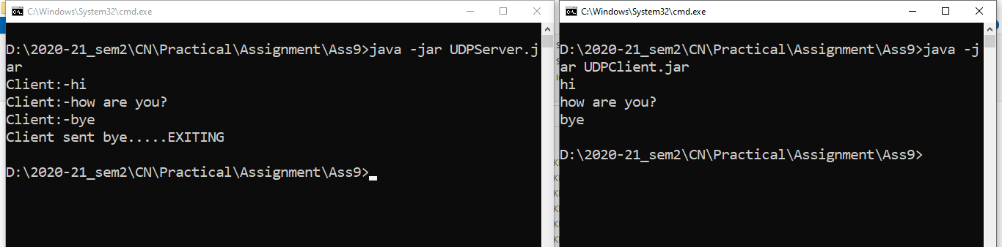
Run UDP Client and Server

Slide 10
Practice Statement
Create a UDP client-server socket program, where client is requesting simple arithmetic operations (addition, subtraction, multiplication, and division) and expecting server to output result of operation.

Slide 11
Sources
https://helpdeskgeek.com/windows-10/install-and-setup-a-website-in-iis-on-windows-10/
https://www.codejava.net/java-se/networking/java-urlconnection-and-httpurlconnection-examples
https://www.w3schools.com/html/
https://medium.com/javarevisited/fundamentals-of-udp-socket-programming-in-java-4a6972370592
https://www.geeksforgeeks.org/working-udp-datagramsockets-java/

Slide 12
Thank You!

